Slide 1
Big Mountain Resort

Slide 2
What?
Recently installed an additional chair lift to help increase the distribution of visitors and it increases the operating costs by $1,540,000 this season. The resort’s pricing has been above the average price of resorts in its market segment, however, there are limitations to this approach. How to set an adequate ticket price that will increase revenue to cover the increased operating cost for the new season that going to start this year

Slide 3
Findings
There still room to increase the ticket price in the current market
Features that came up as important in the modeling
Vertical Drop
Snow Making
Total Charis
Fast Quads
Runs
Longest Run
Trams
Skiable Terrain

Slide 4
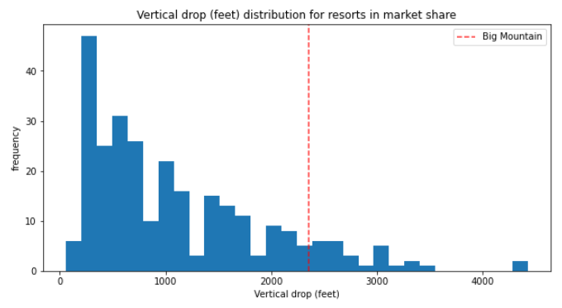
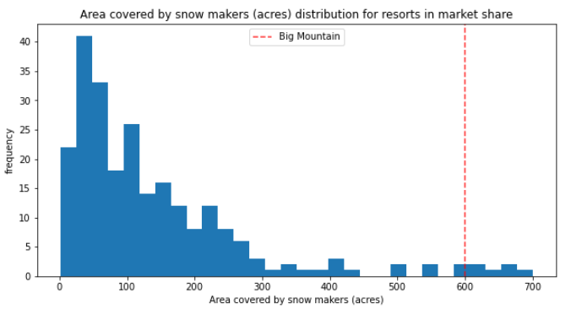
Result – Big Mountain is doing well compared in market share

Slide 5
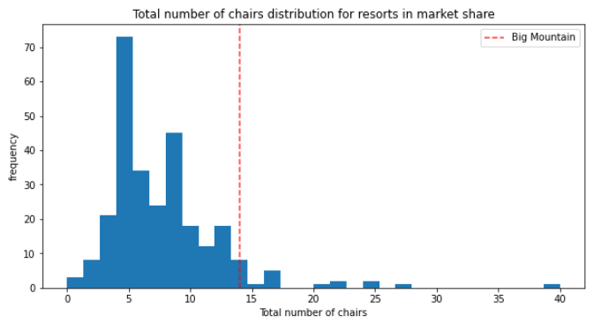
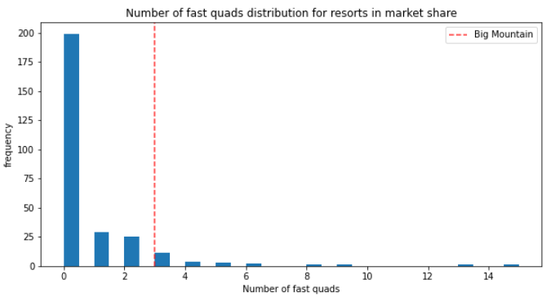
Result – Big Mountain is doing well compared in market share

Slide 6
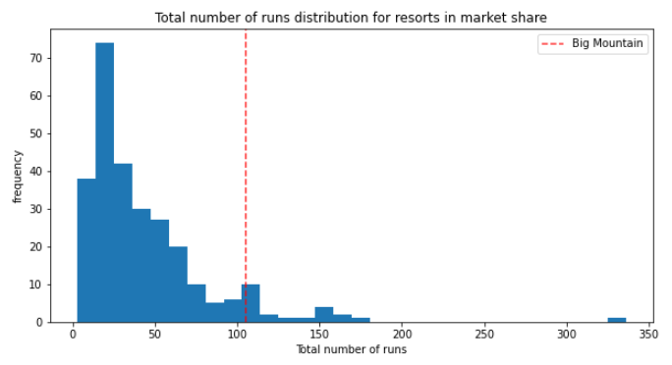
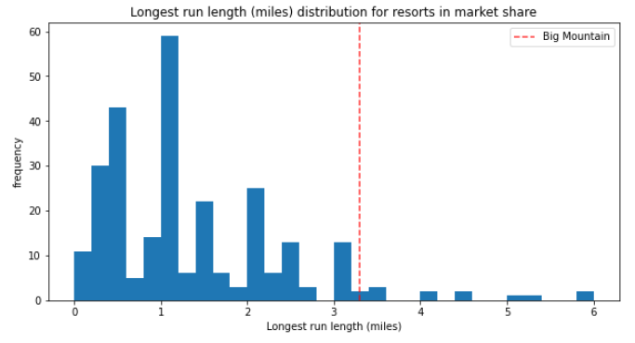
Result – Big Mountain is doing well compared in market share

Slide 7
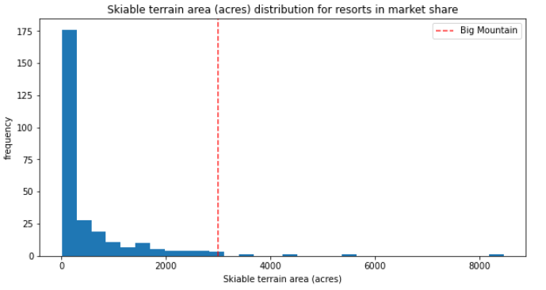
Result – Big Mountain is doing well compared in market share

Slide 8
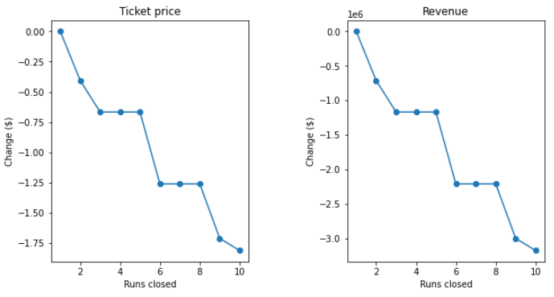
What if

Slide 9
Conclusion
Big Mountain have room to increase ticket price
Cutting Cost? How?

